Slide 1
AI-Based Temperature Regulation System in Poultry Farming
DONE BY,
BRINDHA R A (952021106002) MANJULADEVI S (952021106004)
NANDHINI P (952021106005)
SWETHA G (952021106007)
GUIDED BY,
Mrs. P. VEDHANAYAGI - AP(ECE)

Slide 2
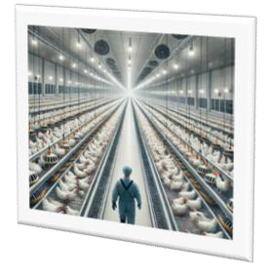
ABSTRACT
Poultry farming is a critical sector in agriculture, providing essential protein sources in the form of eggs and meat. Environmental conditions such as temperature, humidity, and air quality significantly impact poultry growth, health, and productivity. Traditionally, poultry farmers rely on manual monitoring and control mechanisms, which are often inefficient and prone to human error. This study introduces an AI-based automated temperature regulation system designed to optimize environmental conditions, reduce energy consumption, and improve poultry welfare.

Slide 3
Literature Review
S.NO | REFERENCE PAPERS | OBJECTIVE | METHODOLOGY | LIMITATION
1. | Kiwoong Kwon , Sanghak Lee, and Sanghun Kim ,“AI-Based Home Energy Management System Considering Energy Efficiency and Resident Satisfaction”, IEEE INTERNET OF THINGS JOURNAL, VOL. 9, NO. 2, JANUARY 15, 2022(Base Paper) | The paper presents an AI-based Home Energy Management System (AI-HEMS) that optimizes heating control using predictive models, achieving 14% energy savings and 91% resident satisfaction. | -Data collection -AI algorithms -Simulation & Testing | It mainly focuses on heating, lacks adaptation for shared spaces, and relies on smartphone data for sleep prediction.

Slide 4
S.NO | REFERENCE PAPERS | OBJECTIVE | METHODOLOGY | LIMITATION
2. | CHANG DENG1 , ARNAUD PROUZEAU2 , AND CHRISTOPH BERGMEIR1, “A Generative Deep Learning Framework Across Time Series to Optimize the Energy Consumption of Air Conditioning Systems”, Date of publication January 11, 2022, date of current version January 20, 2022. | Develop a generative deep learning framework to optimize energy consumption in air conditioning systems using time-series data. | Implement a deep learning model trained on historical time- series data to predict and optimize AC energy usage. | The framework’s performance depends on data quality, and it may not generalize well to unseen conditions.
3. | SUNARDI, ANTON YUDHANA, (Member, IEEE), AND FURIZAL, “Tsukamoto Fuzzy Inference System on Internet of Things-Based for Room Temperature and Humidity Control”, 3, Date of publication 11 January 2023 | Develop a fuzzy inference system for IoT-based room temperature and humidity control. | Utilize fuzzy logic to process IoT sensor data and adjust environmental conditions dynamically. | The accuracy of the system depends on sensor data quality and predefined fuzzy rules

Slide 5
S NO | REFERENCE PAPERS | OBJECTIVE | METHODOLOGY | LIMITATION
4. | TEOH JI SHENG , MOHAMMAD SHAHIDUL ISLAM ,NORBAHIAH MISRAN , MOHD HAFIZ BAHARUDDIN , HASLINA ARSHAD , “An Internet of Things Based Smart Waste Management System Using LoRa and Tensorflow Deep Learning Model”, Date of publication August 12, 2020. | Develop an IoT-based smart waste management system using LoRa communication and TensorFlow deep learning for efficient waste monitoring. | Implement LoRa- enabled sensors to collect waste data, process it using a TensorFlow deep learning model, and optimize collection routes. | System performance relies on sensor accuracy, network coverage, and model generalization to different waste patterns.
5. | CHIH-YUAN CHANG1 , SY-JYE GUO2 , SAN-SHAN HUNG3 , AND YI-TING LIN, “Performance Analysis of Indoor Smart Environmental Control Factors: Using Temperature to Control the Rate of Formaldehyde Emission.” Date of publication October 29, 2019. | Propose an IoT-based smart system utilizing LoRa and deep learning to enhance waste management efficiency. | Deploy LoRa sensors to collect waste data, analyze it with a TensorFlow deep learning model, and optimize collection schedules. | The system's effectiveness depends on sensor reliability, network coverage, and model adaptability to varying waste patterns.

Slide 6
S NO | REFERENCE PAPERS | OBJECTIVE | METHODOLOGY | LIMITATION
6. | Alain Martinez , Erik Hernandez- Rodríguez, Luis Hernandez, Olivier Schalm, “Design of a Low-Cost System for the Measurement of Variables Associated With Air Quality”, IEEE EMBEDDED SYSTEMS LETTERS, VOL. 15, NO. 2, JUNE 2023. | To develop a low-cost system for measuring air quality variables efficiently. | The system integrates low-cost sensors and microcontrollers to collect, process, and transmit air quality data. | The accuracy of low- cost sensors may be affected by environmental conditions and calibration challenges.
7. | Kgoputjo Simon Elvis Phala, Anuj Kumar, and Gerhard P. Hancke, Senior Member, IEEE, “Air Quality Monitoring System Based on ISO/IEC/IEEE 21451 Standards”, IEEE SENSORS JOURNAL, VOL. 16, NO. 12, JUNE 15, 2016. | Develop an air quality monitoring system based on ISO/IEC/IEEE 21451 standards for accurate environmental assessment. | Utilize standardized smart transducers and communication protocols to collect and analyze air quality data. | Utilize standardized smart transducers and communication protocols to collect and analyze air quality data.

Slide 7

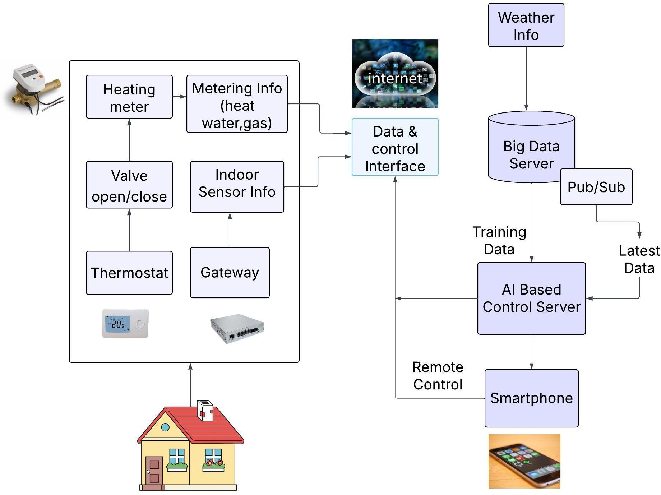
Existing System

Slide 8

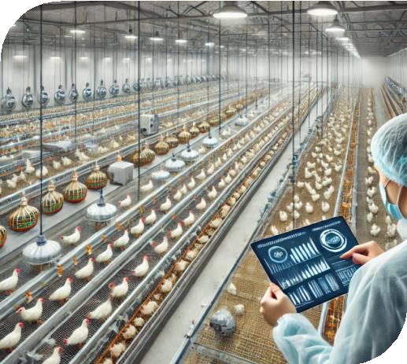
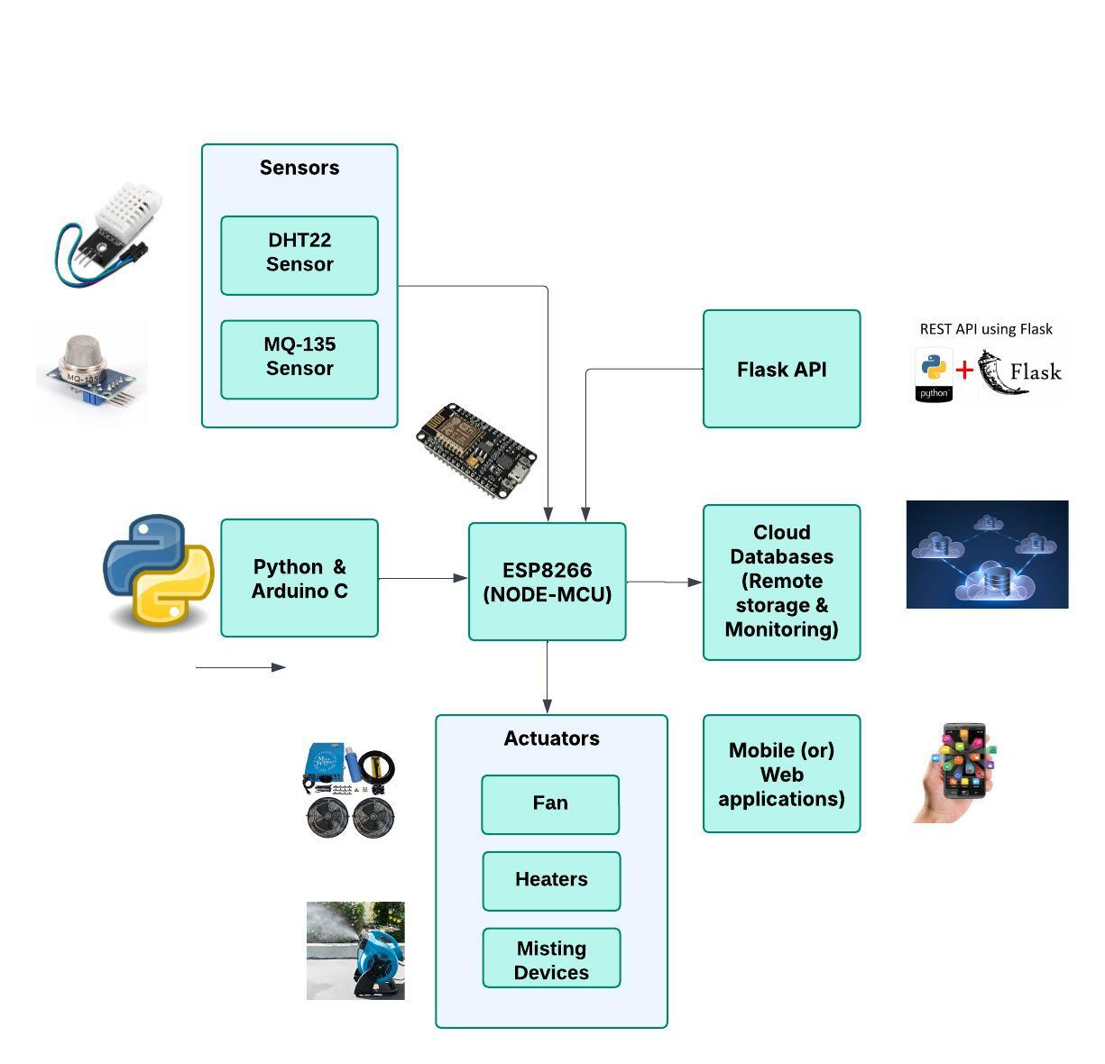
Proposed System

Slide 9
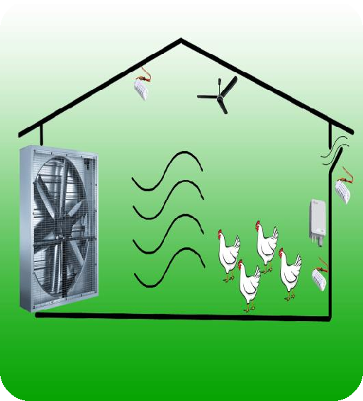

System Design
AI-Driven Environmental Control
Inspired by AI-HEMS, the system derives optimal temperature levels using machine learning models trained on historical environmental data and poultry behavior patterns.
Predictive analytics help regulate temperature dynamically, preventing heat stress or cold exposure.

Slide 10
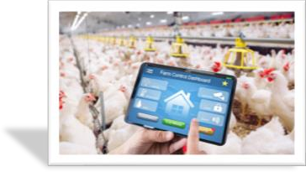
IoT-Based Monitoring System
The system employs IoT sensors such as DHT22 for temperature and humidity detection, MQ-135 for air quality monitoring, and ESP8266 micro controller for data processing and communication.
These sensors continuously collect real-time data and transmit it to a cloud-based platform for analysis.

Slide 11
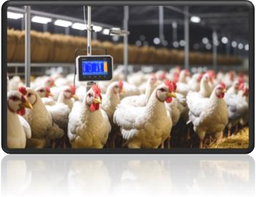
Automated Control Mechanisms
Based on sensor data and AI predictions, the system automatically adjusts ventilation, heating, and cooling systems.
Actuators control fans, heaters, and misting systems to maintain optimal conditions without manual intervention.

Slide 12
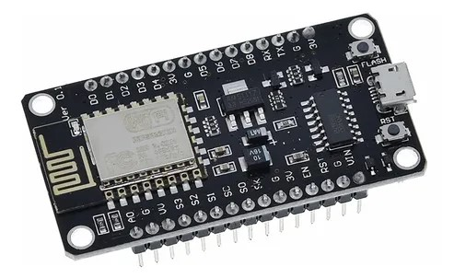
Hardware and Software Components
Hardware Components
ESP8266 : The ESP8266 is a Wi-Fi-enabled microcontroller module
that allows devices to connect wirelessly to the internet. It’s commonly
used in IoT projects due to its low cost, compact size, and built-in
networking capability.
Range :
Wi-Fi Range: Up to 100 meters in open space (30–50 meters indoors).
Frequency: 2.4 GHz (IEEE 802.11 b/g/n)
Voltage: 3.0–3.6V (typically 3.3V)

Slide 13
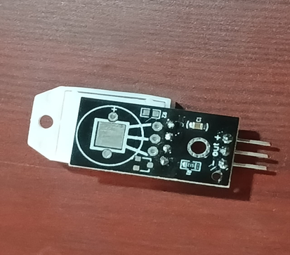
DHT22 Sensor:
The DHT22 is a digital sensor used to measure temperature and humidity. It uses a thermistor and a capacitive sensor to collect data and sends it digitally to a microcontroller.
Range:
🌡Temperature Range: -40°C to +80°C
🎯 Temperature Accuracy: ±0.5°C
💧 Humidity Range: 0% to 100% RH
🎯 Humidity Accuracy: ±2% to ±5% RH
🔍 Resolution: 0.1°C and 0.1% RH

Slide 14
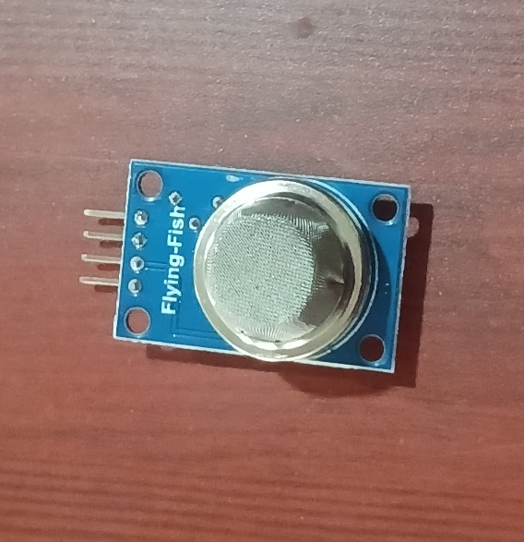
MQ-135 Sensor:
The MQ-135 sensor detects harmful gases by changing its
resistance when exposed to them. This change is converted into
an analog voltage output, which varies with gas concentration.
Range:
Detects gas concentrations approximately from 10 ppm to 1000 ppm
Sensitive to gases like ammonia (NH3), benzene, alcohol, and smoke
Not highly accurate for CO2 but can detect it to some extent

Slide 15
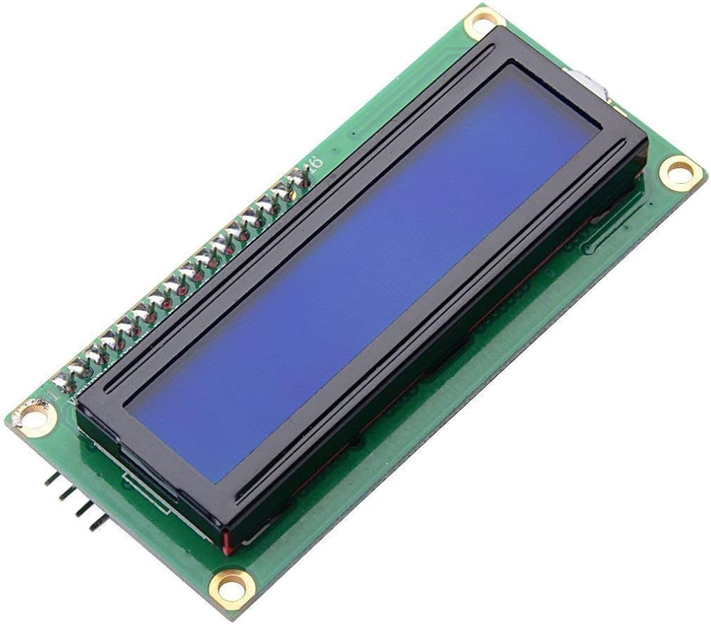
Lcd Display:
LCD stands for Liquid Crystal Display
Uses liquid crystals to control light passage and display images or text
Does not emit light; relies on backlight or ambient light
Liquid crystals align when electric current is applied, blocking
or allowing light
Character LCD: Displays fixed text (e.g., 16x2, 20x4)

Slide 16
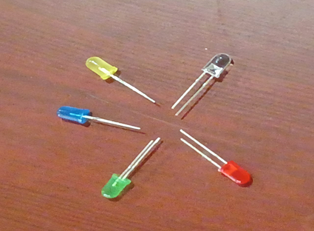
Actuators(LCD):
    Cooling fans activate during high temperatures.
    Heaters maintain warmth in low temperatures.
    Misting system helps in lowering temperature and increasing humidity.
.

Slide 17
Software Components
Arduino IDE (C):
Purpose : Used to program the ESP8266 microcontroller.
Role : Controls the hardware components such as sensors and actuators based on logic written in C/C++.
Functionality : Facilitates communication between the ESP8266 and other sensors like DHT22 and MQ-135

Slide 18
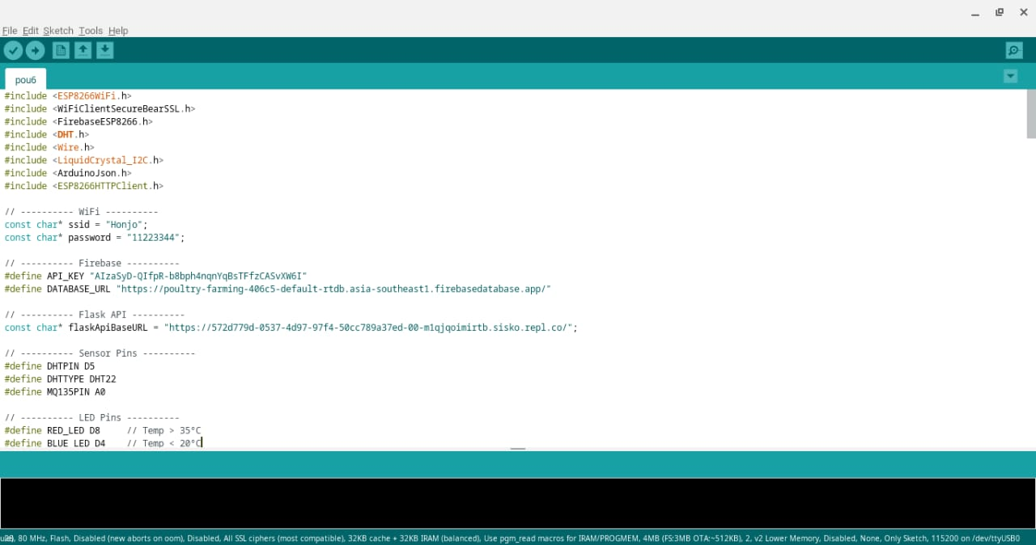

Slide 19
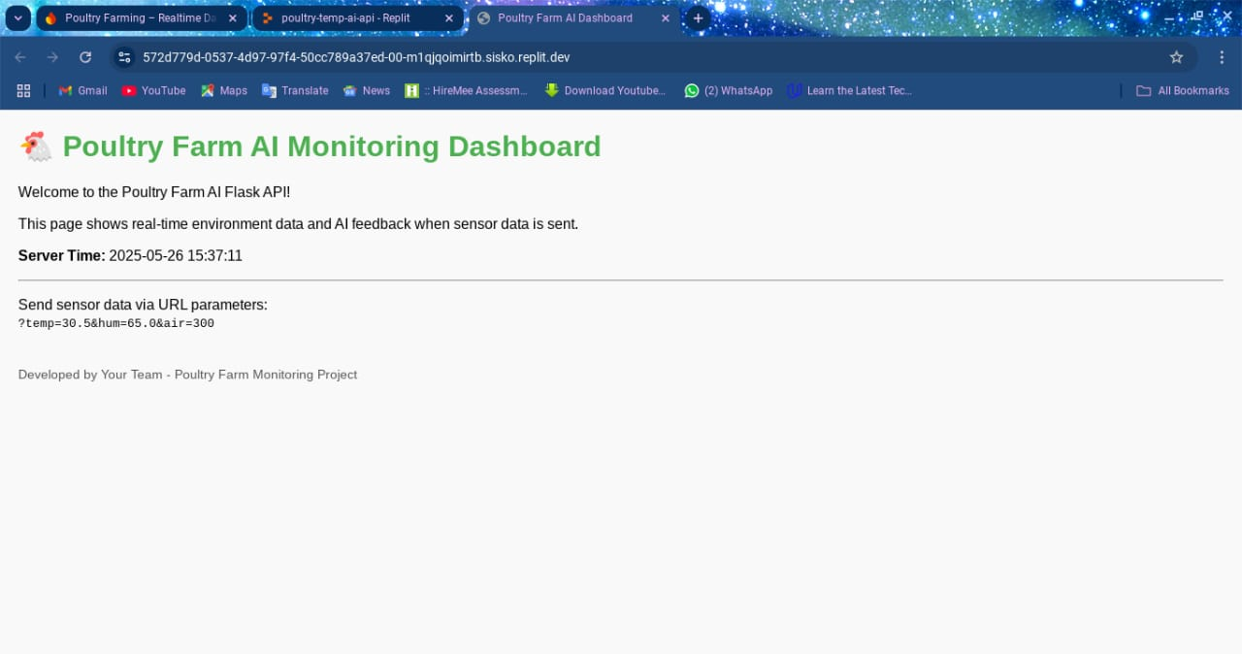
Flask API:
Purpose : A lightweight web framework in Python.
Role : Provides an interface to expose sensor data and prediction outputs via RESTful APIs.
Functionality : Acts as a communication layer between the sensor data processing and external user interfaces or dashboards.

Slide 20
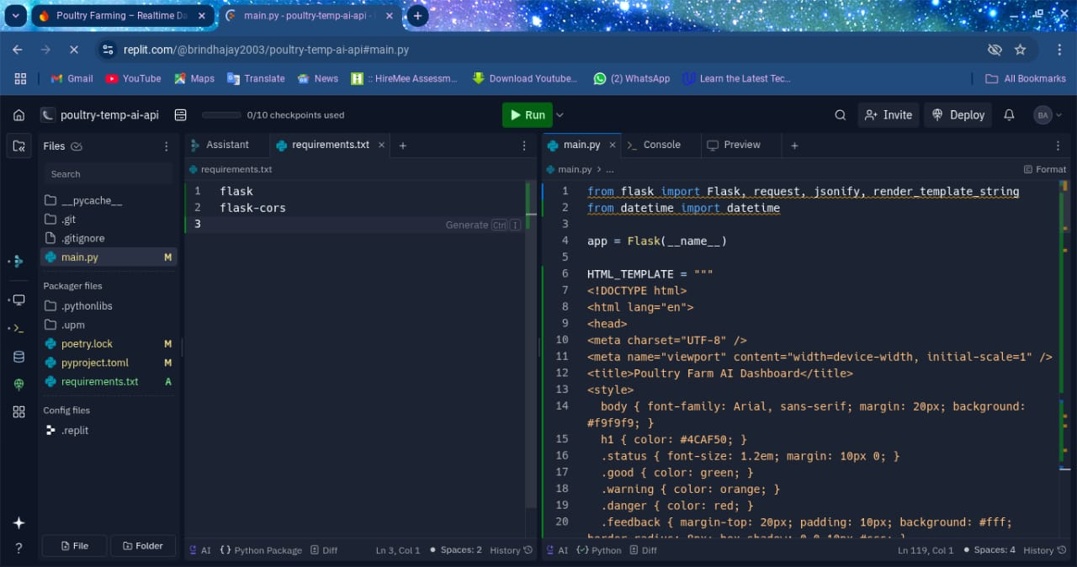

Slide 21
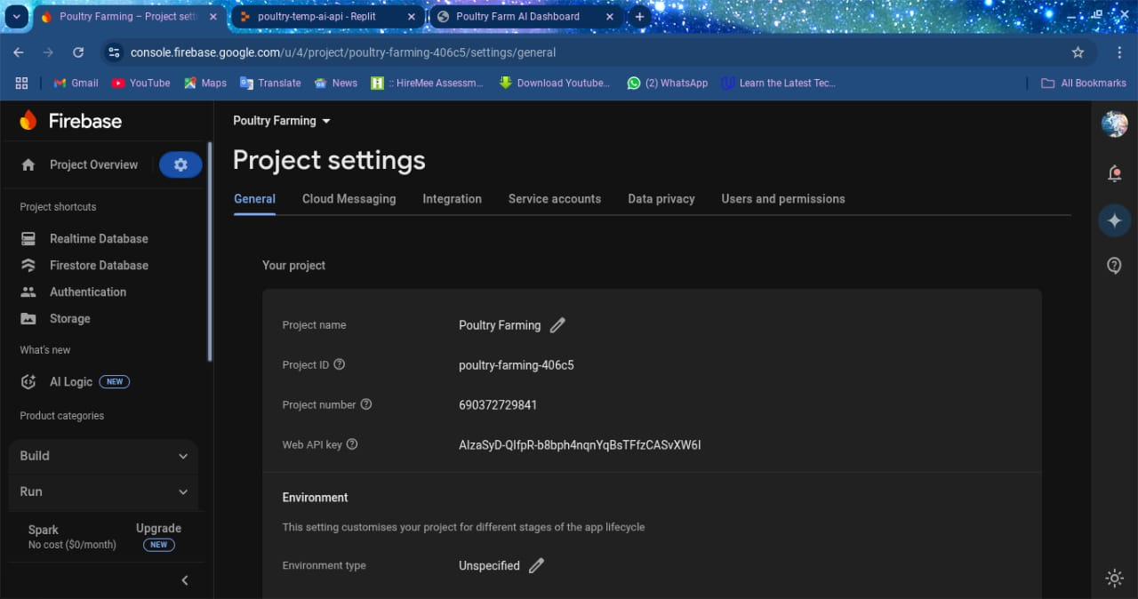
Cloud Database (Firebase):
Purpose : Cloud-based real-time database service.
Role : Stores real-time data from sensors for monitoring and future analysis.
Functionality : Allows remote access to historical and real-time environmental data for decision-making and system control.

Slide 22
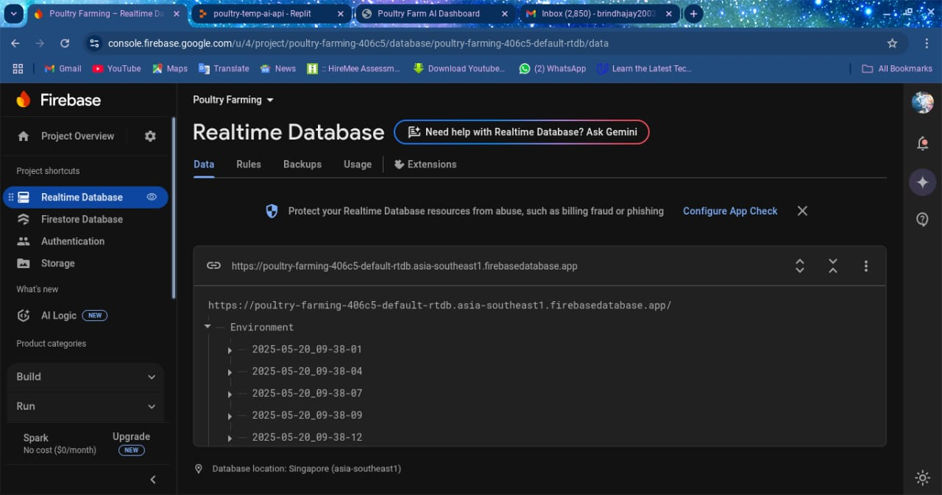
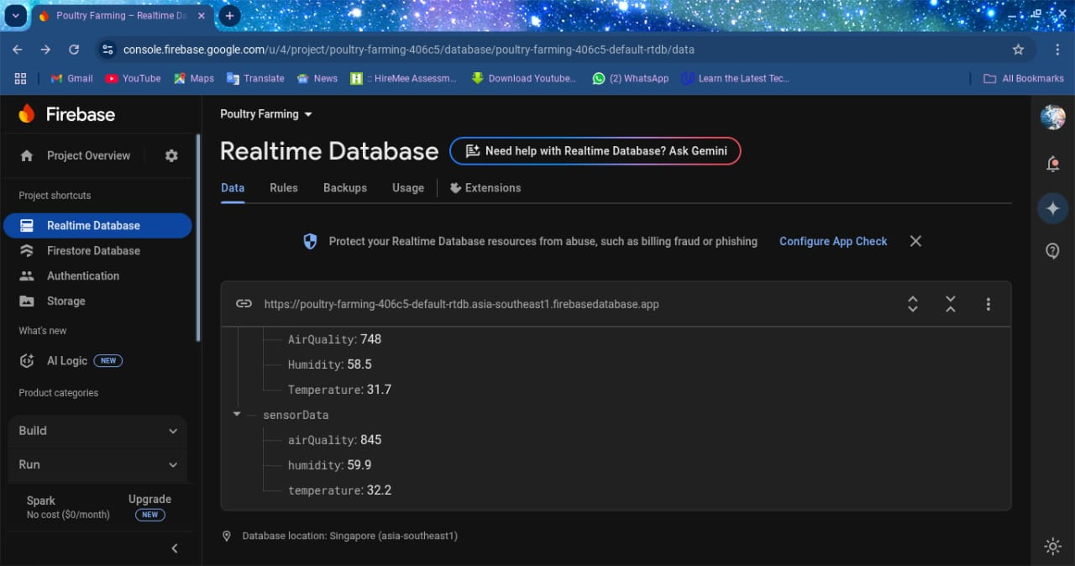

Slide 23
Program: Sample Arduino Code (ESP8266)
#include &lt;DHT.h&gt;
#include &lt;ESP8266WiFi.h&gt;
#include &lt;FirebaseESP8266.h&gt;
#define DHTPIN D4
#define DHTTYPE DHT22
DHT dht(DHTPIN, DHTTYPE);
void setup() {
Serial.begin(115200);
dht.begin();
// WiFi and Firebase initialization
}
void loop() {
float temperature = dht.readTemperature();
float humidity = dht.readHumidity();
// Upload to Firebase and control logic
delay(5000);
}

Slide 24
Program: Firebase Database Structure
{
”Readings”: {
”2025-05-26 14:35:00”: {
”Temperature”: 31.7,
”Humidity”: 62.9,
”AirQuality”: 808
},
”2025-05-26 14:40:00”: {
”Temperature”: 32.1,
”Humidity”: 63.2,
”AirQuality”: 780
}
}
}

Slide 25
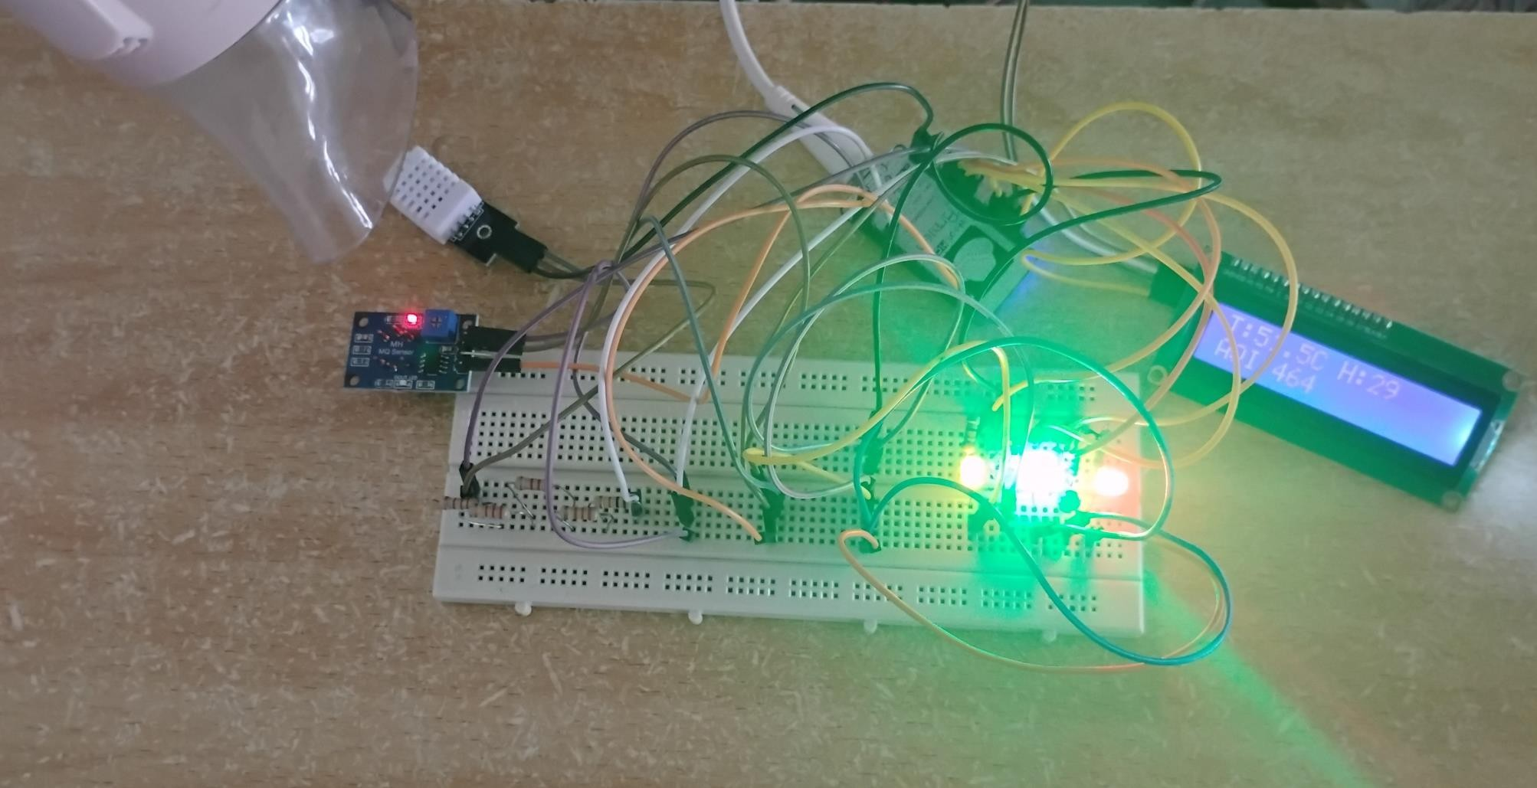
Result:

Slide 26
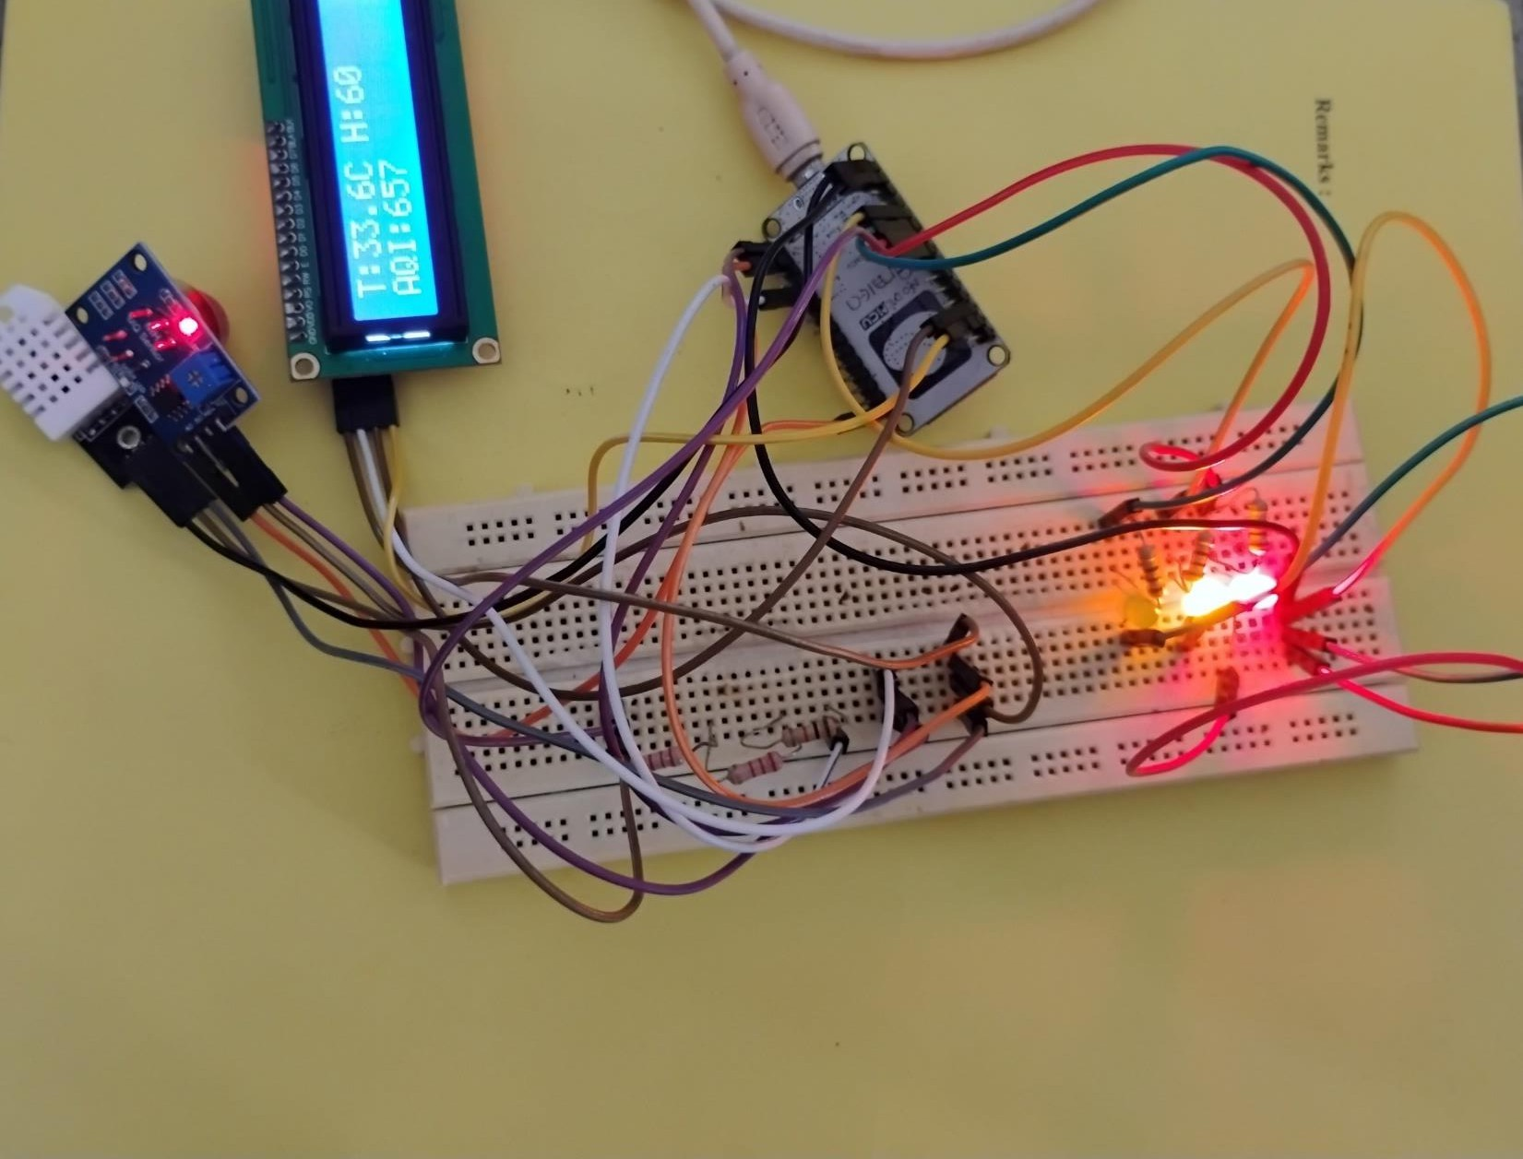

Slide 27
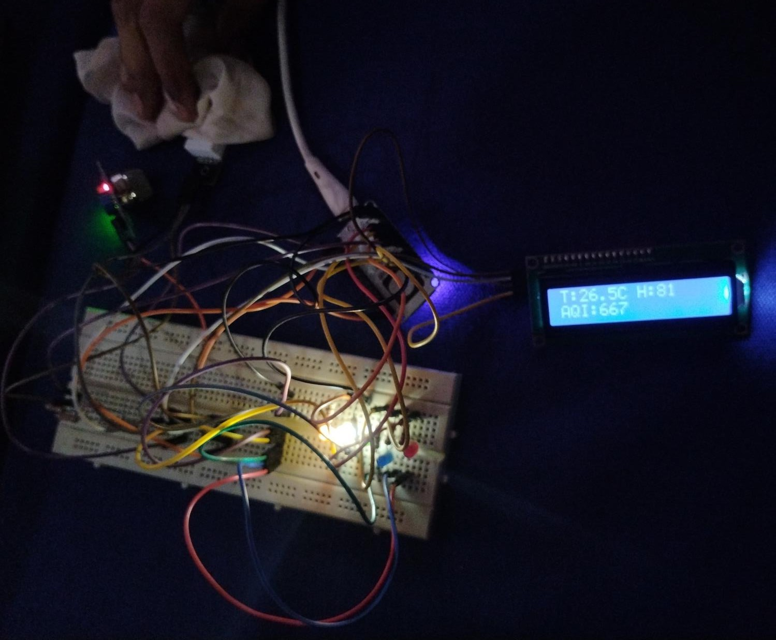

Slide 28
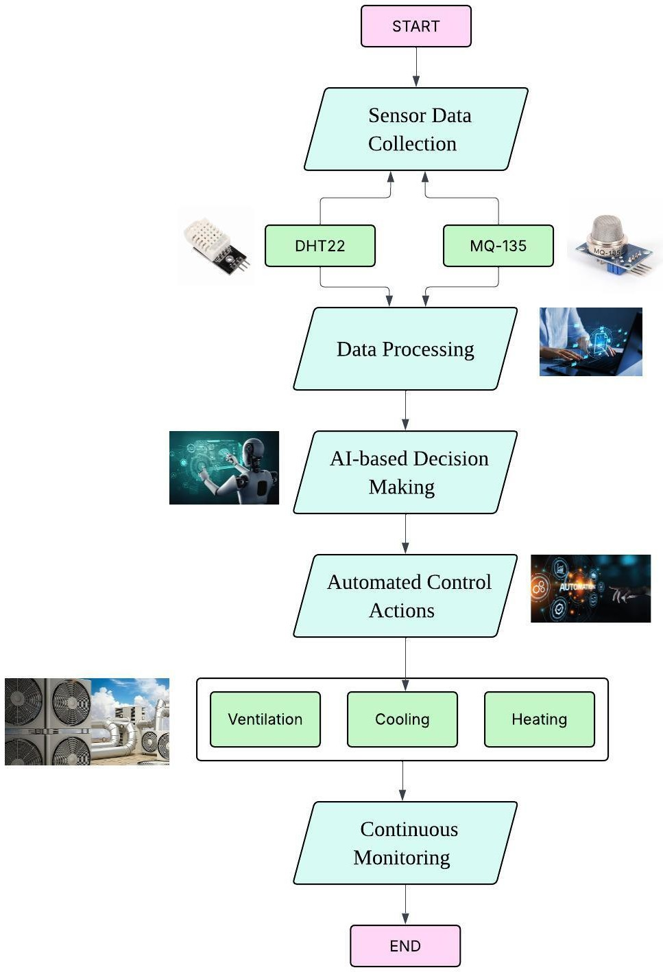
FLOW DIAGRAM

Slide 29
Conclusion
This study demonstrates the feasibility of an AI-powered, IoT- enabled temperature regulation system for poultry farming. By leveraging advanced automation, predictive analytics, and real-time monitoring, the system enhances poultry welfare while reducing operational costs. Future work will focus on integrating advanced machine learning models for disease prediction and automated feeding systems.

Slide 30
ANY QUERIES…???

Slide 31
THANK YOU ☺☺☺☺

